Slide 1

Using Vision Foundation Models
Before Fine-Tuning: Different Ways to Apply Pretrained Foundation Models

Slide 2
What can we do with a foundation model besides retraining it?
A foundation model is not simply a model that we fine-tune for a new task. Its pretrained representations can be reused, queried, adapted, and combined with other models to solve many computer vision problems.
Pretrained Foundation Model
↓
Use directly → Zero-shot classification, VQA
Extract representations → Embeddings, retrieval, clustering
Prompt → Detection, segmentation, multimodal reasoning
Adapt → Linear probing, LoRA/PEFT, fine-tuning
Integrate → Larger computer vision / multimodal AI systems

Slide 3
Uses of Vision Foundation Models
A pretrained foundation model may be able to support many vision tasks without full retraining
Foundation Model Use | What It Enables | Example
Feature Extraction / Embeddings | Reusable learned visual representations | Image similarity, clustering, downstream classification
Zero-Shot Classification | Recognize categories without task-specific training | CLIP/SigLIP-style classification
Semantic Image Retrieval | Search images using images or natural language | Text → matching images
Open-Vocabulary Detection | Detect objects specified through language | Text-prompted object detection
Promptable Segmentation | Segment objects without training a new segmentation model | SAM-family models
Structured Visual Extraction | Convert visual information into structured data | Image → objects/attributes/JSON
Model Adaptation | Specialize a foundation model for a domain/task | LoRA/PEFT or fine-tuning
AI/CV System Component | Combine foundation models with specialized vision models and tools | Detector → VLM → reasoning/action

Slide 4
Feature Extraction & Embeddings

Slide 5
Feature Extraction & Embeddings: Motivation Example — Wildlife Image Classification
Problem:
Suppose we have only 50–100 labeled images each of several local wildlife species.
Traditional approach
Images → SIFT/HOG/ORB → SVM
We must decide which visual features to engineer.
Deep-learning approach
Images → Train/Fine-tune CNN → Species
Our dataset may be too small to learn strong visual representations.
Foundation-model embedding approach
Images → Foundation Model → Embeddings → KNN/SVM/Small Classifier
The foundation model supplies a powerful pretrained representation, while we control the final task-specific decision model.
But Why Not Just Use the Foundation Model Directly?
For example: Image → VLM / Foundation Model → "Bobcat"
Sometimes that is exactly what we should do. But extracting embeddings can be preferable when:
  Our classes are specialized or domain-specific. The pretrained model may not reliably distinguish the categories we care about.
  We need consistent, constrained outputs. A classifier produces one of our defined classes rather than generating an unconstrained answer.
  We have only a small amount of labeled data. We can train a lightweight classifier without retraining the large foundation model.
  We need efficiency. Compute embeddings once and use inexpensive KNN/SVM/linear models afterward.
  We want retrieval or similarity, not just recognition. Embeddings let us ask “Which images are most similar to this one?”
  We want to use our own classes without changing the foundation model.
A foundation model can therefore be either the complete vision system OR a reusable source of learned visual features.

Slide 6
Why use embeddings if prompting + memory works?
1. Scale.
Suppose you have 1 million wildlife images and want to find the 500 most similar to a newly submitted image.
You don't want to send one million images through a VLM prompt.
Instead:
1M Images → Foundation Model → Embeddings → Vector Database
Then:
New Image → Embedding → Similarity Search → Top Matches
This is one of the strongest motivations for embeddings.
2. Retrieval itself is the task.
Sometimes you aren't asking:“ What animal is this?”
You're asking: “Find images visually/semantically similar to this one.”
That's fundamentally an embedding-space problem.
3. Clustering / discovering structure.
Suppose you have 50,000 unlabeled images.
Images → Embeddings → Clustering
You might discover groups corresponding to animals, environments, viewpoints, unusual cases, etc. There isn't necessarily a predetermined recognition label to prompt for.
4. Cheap repeated classification.
Suppose every day your system receives 100,000 images that must be classified into the same 20 categories.
A large VLM call for every image may be unnecessarily expensive or slow.
Instead:
Foundation Model → embedding → tiny classifier
The expensive representation model can potentially be smaller/specialized, and the downstream decision is deterministic and inexpensive.
5. Quantitative ML analysis.
Embeddings give students an actual numerical representation they can manipulate:
distance(image A, image B)
They can perform:
KNN → SVM → clustering → PCA/t-SNE/UMAP → anomaly detection → retrieval
That's important pedagogically because it connects directly to the feature vectors you already teach in traditional CV.

Slide 7
Foundation Models for Semantic Image Retrieval
Use learned embeddings to search by meaning—not filenames, labels, or exact pixels

Slide 8
MOTIVATION - Foundation Models for Semantic Image Retrieval
Suppose we have 100,000 unlabeled wildlife images and receive a new image of an animal.
We want to ask: “Find the images in my collection that are most similar to this image.”
A VLM could describe the image, but asking the VLM to compare the query against every image individually would be expensive and inefficient.
Foundation Model Approach
One-time processing:
100,000 Images
↓
Vision Foundation Model
↓
100,000 Embeddings
↓
Vector Database / Embedding Index
At query time:
New Image
↓
Same Foundation Model
↓
Query Embedding
↓
Similarity Search
↓
Top-K Similar Images
Why Is This Powerful?
The comparison is performed in a learned semantic feature space, rather than simply comparing pixels.
Therefore, similar images do not have to have: the same resolution, the same background, the same viewpoint, identical colors, or identical pixels.
Instead, their learned representations can be similar.
Even More Powerful: Image ↔ Text Retrieval
With a multimodal foundation model that places images and text in a compatible embedding space:
Text: "a large cat walking at night"
↓
Text Embedding
↓
Vector Search
↓
Matching Images
Now we can search an image collection without manually assigning labels to every image.
Connection to VLMs and Memory --- One modern pipeline is:
User Image → Embedding → Retrieve Relevant Images/Information → Add to VLM Context → Reason
Foundation-model embeddings turn large collections of visual information into searchable semantic memory.

Slide 9
Zero-Shot Image Classification
Recognize new categories without training a task-specific classifier

Slide 10
Foundation Models Can Support
Zero-Shot Classification in Different Ways
IMAGE
|
ZERO-SHOT CLASSIFICATION
/ \
/ \
Generative VLM Embedding Model
Gemini* / Qwen-VL*** CLIP** / SigLIP*
| |
Prompt defines Text descriptions
candidate classes define classes
| |
Generates answer Similarity comparison
| |
BOBCAT BOBCAT
Generative / instruction-following VLM — Gemini, GPT vision models, Qwen-VL, etc.
You specify the task and classes in natural language:
Image + Prompt:
“Classify this animal as exactly one of: Bobcat, Mountain Lion, Coyote, Gray Fox.”
→ Gemini → “Bobcat”
No task-specific training examples → zero-shot classification.
The candidate classes are defined at inference time through the natural-language prompt (see example slide).
2. Embedding-based vision-language model — CLIP/SigLIP-style
You specify the classes through text:
  "a photo of a bobcat"
  "a photo of a mountain lion"
  "a photo of a coyote"
  "a photo of a gray fox"
The model compares:
Image embedding ↔ candidate text embeddings
→ highest similarity → Bobcat
* Google
** OpenAI
*** Alibaba

Slide 11
Zero-Shot Image Classification w/CLIP
But Why Not Just Ask a VLM?
We could Image + “What animal is this?” → VLM → “Bobcat”
So why use zero-shot classification?
Zero-shot classification is useful when we want:
  A fixed, controlled set of candidate classes
  Quantitative similarity scores for each class
  Efficient Large-scale automated classification
Important Modern Concept
The prompt itself can affect classification. Compare: "bobcat“ with "a photograph of a bobcat in its natural habitat“ or even several descriptions of the same class.
This introduces prompt engineering for representation-based vision, not just prompting a conversational VLM.
Progression
Traditional CV:
Features → Classifier → Fixed Classes
Deep Learning:
CNN → Learned Features → Fixed Classes
Foundation Models:
Image + Natural-Language Classes → Zero-Shot Prediction
Takeaway
Foundation models can move the definition of the recognition task from training time to inference time.
Suppose our wildlife system needs to recognize: Bobcat • Mountain Lion • Coyote • Gray Fox • Raccoon
Traditionally: Labeled Images → Train Classifier → Fixed Classes
Adding a new class usually means obtaining examples and retraining or updating the classifier.
Foundation Model Approach
With a vision-language foundation model: Image → Image Embedding
and candidate class descriptions:
  "a photo of a bobcat" → Text Embedding
  "a photo of a mountain lion" → Text Embedding
  "a photo of a coyote" → Text Embedding
  "a photo of a gray fox" → Text Embedding
Then:
  Compare Image Embedding ↔ Text Embeddings
  ↓
  Select the most similar class
Why “Zero-Shot”?
The model was not specifically trained on our wildlife classification dataset.
We define the classes at inference time using natural language.
Want to add a new class?
  Add: "a photo of a black bear"
  No conventional classifier retraining is required.
Contrastive Language–Image Pre-training (CLIP). It is a vision-language model architecture introduced by OpenAI that learns to associate images with natural-language descriptions. CLIP models adjusts both image and text encoders so that:
Matching image and text representations become more similar, while nonmatching ones become less similar.
Example next slide

Slide 12

CLIP based Zero-Shot Image Classification Example: Is This a Bobcat?
CLIP models adjusts both image and text encoders so that:
Matching image and text representations become more similar, while nonmatching ones become less similar.
Step 1 — Image
↓ CLIP Image Encoder
Image Embedding (Bobcat Image → CLIP Image Encoder → Image Embedding)
image embedding is a numerical representation of an image learned by a neural
network. You can think of it as the modern ML equivalent of a feature vector.
Step 2 — Candidate classes
Step 3 — Prediction
Image ↔ Text Similarity → Bobcat
[0.18, -0.42, 0.73, 0.05, ..., -0.21]
Text Prompt | Similarity to Image
“a photo of a bobcat” | 0.91
“a photo of a mountain lion” | 0.72
“a photo of a coyote” | 0.38
“a photo of a gray fox” | 0.31
CLIP encodes each candidate description and compares it with the image embedding.

Slide 13
CLIP based Zero-Shot Image Classification: Adding a New Class Example
New requirement: recognize Black Bears
RECALL Traditional trained classifier
Collect bear images → Label → Retrain → Evaluate → Redeploy
CLIP zero-shot
Simply add: "a photo of a black bear"
Huh????

Slide 14
CLIP based Zero-Shot Image Classification: Adding a New Class Example
Defined by your application at runtime:
Your program chooses the text strings it wants CLIP to compare against:
    candidate_classes = [
    "a photo of a bobcat",
    "a photo of a mountain lion",
    "a photo of a coyote",
    "a photo of a gray fox"
    ]
Your program passes those four strings through the already-trained CLIP text encoder.
Now somebody says: we also need to recognize black bears.
You change your application's candidate list, not CLIP:
  candidate_classes = [
  "a photo of a bobcat",
  "a photo of a mountain lion",
  "a photo of a coyote",
  "a photo of a gray fox",
  "a photo of a black bear"
  ]
CLIP already knows how to turn the words "a photo of a black bear" into an embedding because its text encoder was pretrained to represent language and align it with visual concepts.
Then your application does:
PRETRAINED CLIP
(weights do not change)
Bear Image ──→ Image Encoder ──→ Image Embedding
│
│ similarity
↓
"bobcat" ─────────→ Text Encoder → Text Embedding
"coyote" ─────────→ Text Encoder → Text Embedding
"gray fox" ───────→ Text Encoder → Text Embedding
"black bear" ─────→ Text Encoder → Text Embedding
│
highest similarity
↓
BLACK BEAR
You create the classification task at inference time by supplying the candidate text descriptions…→ “For this particular problem, compare the image against these five textual concepts.””

Slide 15
Zero-shot ≠ guaranteed accuracy. → reminder we sometimes need to Retrain/Fine-Tune

Slide 16
Open-Vocabulary Object Detection Models *
Detect and localize objects using categories specified at inference time
* These are specialized Foundation models; not all vision foundation models perform open-vocabulary object detection.

Slide 17
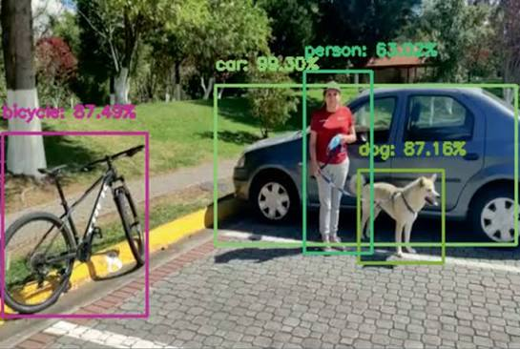
Open-Vocabulary Object Detection Models-> Motivation
Open-Vocabulary Detection
A vision foundation model can allow us to specify the objects of interest using natural language at inference time:
Image + Text Queries
    "person"
    "dog"
    "red backpack"
    "fire hydrant"
    ↓
    Open-Vocabulary Detector
    ↓
    Bounding Boxes + Labels + Scores
    For example, given a street image:
    Prompt: "person, bicycle, dog, car"
Motivation
So far: Zero-shot classification asks: “What is the main object in this image?”
But many computer vision applications need:
“What objects are present, and WHERE are they?”
Traditional Object Detection
    Training Images + Bounding-Box Labels
    ↓
    Train / Fine-Tune Detector
    ↓
    Fixed set of classes:
    person | car | dog | bicycle
The detector's recognition vocabulary is largely established during training.
Open-vocabulary detection
Image Regions ↔ Text Concepts
asks:
Which regions of this image correspond to the concepts I specified?
Example Models
:
Grounding DINO — text-conditioned/open-set object detection (Meta)
OWL-ViT / OWLv2 — open-vocabulary object detection (Google)

Slide 18
Open-Vocabulary Object Detection Models-> CLARIFICATION
Traditional detector such as YOLO | Open-vocabulary detector
Input: Image | Inputs: Image + Text
Finds/localizes objects | Finds/localizes objects
Produces bounding boxes | Produces bounding boxes
Predicts from a learned/fixed class set | Matches detections to text-specified concepts
person, car, dog... established by training | "person", "black bear", "yellow hard hat" supplied at inference
Primarily vision | Multimodal: vision + language
YOLO-style closed-vocabulary detection
IMAGE → Vision Detector → Boxes + Fixed Class Labels
versus
Open-vocabulary detection
What does the language actually contribute?
That's the interesting part.
A conventional YOLO detector might have learned an output vocabulary such as:
person | bicycle | car | dog | ...
Its detector learns to associate visual features with those particular trained classes.
An open-vocabulary detector instead learns relationships between visual features and language representations.
So you can supply:
"yellow construction helmet"
The text gets encoded into a learned language representation. The model then tries to identify regions of the image whose visual representations correspond to that textual concept.
That's closely related to the image↔text alignment idea you just taught with CLIP, but now we have localization:
CLIP-style classification
Whole Image ↔ Text
Open-vocabulary detection
Image Regions ↔ Text
IMAGE ──────────┐
↓
Detector → Bounding Boxes + Labels
↑
TEXT QUERY ─────┘
"black bear"
"yellow hard hat"
"red backpack"

Slide 19
Open-Vocabulary Object Detection Models-> CLARIFICATION
What does the language actually contribute?
A conventional YOLO detector might have learned an output vocabulary such as: person | bicycle | car | dog | ...
Its detector learns to associate visual features with those particular trained classes.
An open-vocabulary detector instead learns relationships between visual features and language representations.
So you can supply:
"yellow construction helmet"
The text gets encoded into a learned language representation. The model then tries to identify regions of the image whose visual representations correspond to that textual concept.
CLIP-style classification
Whole Image ↔ Text
Open-vocabulary detection
Image Regions ↔ Text
object detection + language grounding:
Image + natural-language query → localized visual concepts

Slide 20
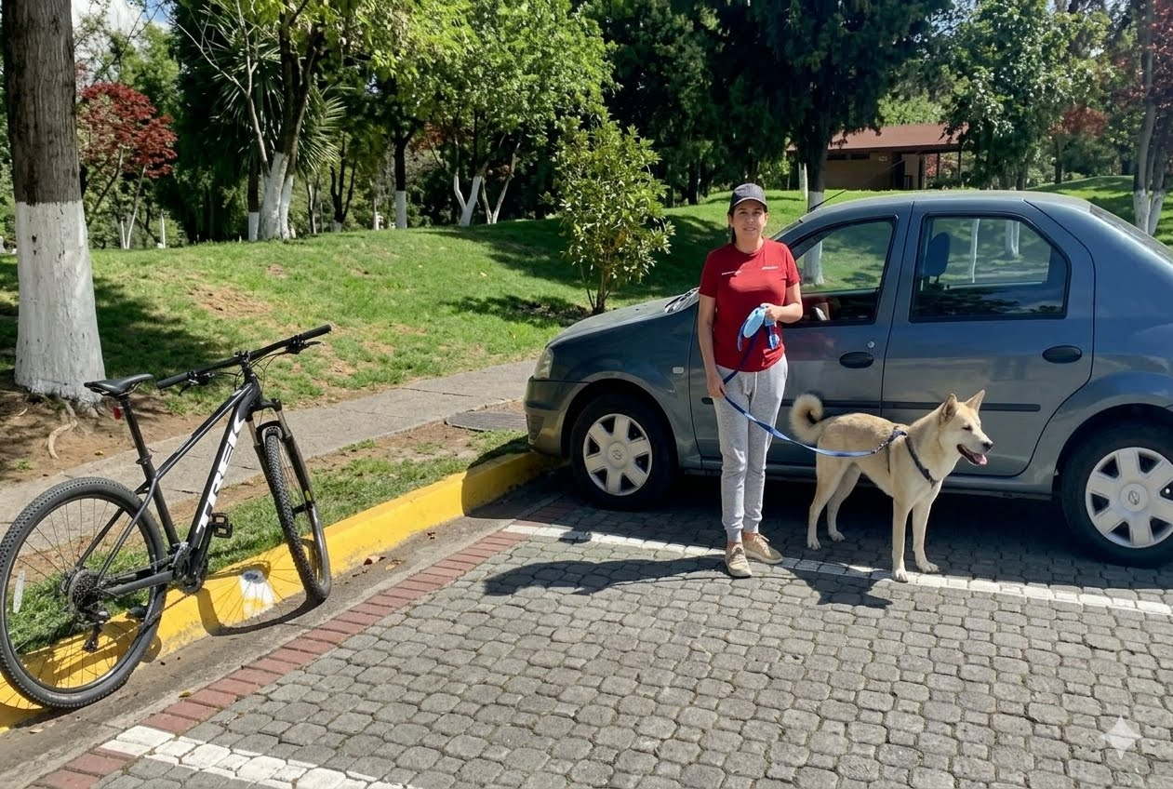
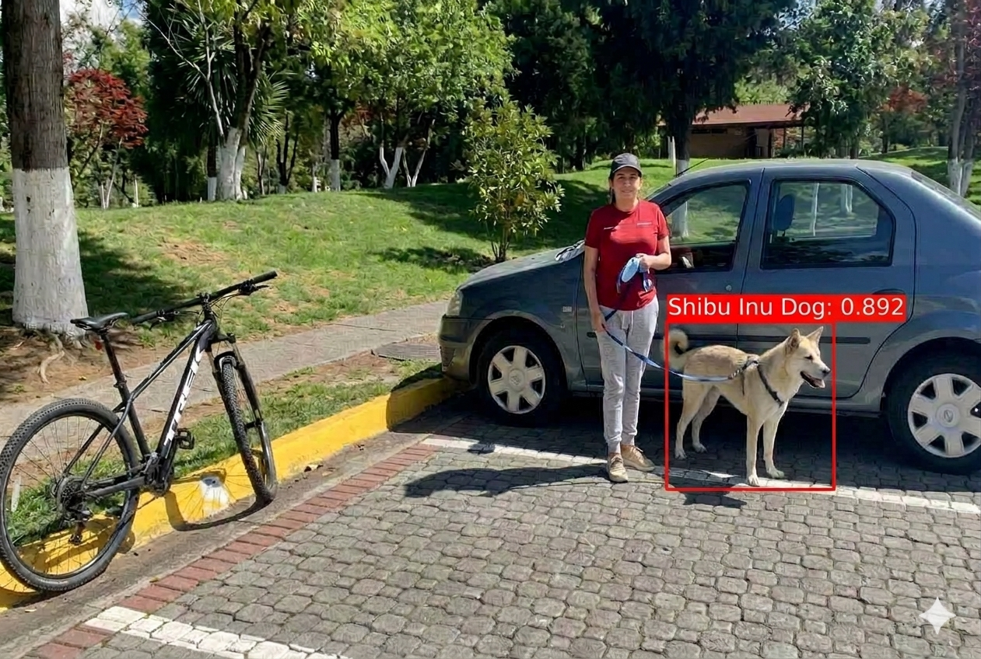
How Open-Vocabulary Detection Works
Key Concept — Visual Grounding
Visual grounding connects a natural-language concept or description to a specific location in an image.
For example:
  Text: "the person wearing a yellow construction helmet"
  ↓
  Model identifies the image region corresponding to that description
  ↓
  Bounding Box
Object Detection + Language Grounding
Two Inputs
  1. Image
    Image → Vision Encoder → Visual Features / Candidate Regions
  2. Natural-Language Query
    “Shiba Inu Dog”
    ↓
    Text Encoder
    ↓
    Text Representation
Bring Vision + Language Together
Connection to What We Already Know
CLIP-style zero-shot classification
  Whole Image ↔ Text Concept
  Does this image correspond to “Shiba Inu Dog”?
Open-Vocabulary Detection
  Image Regions ↔ Text Concept
  Where are the “Shiba Inu Dogs” in this image?
Traditional YOLO-style Detection
  Image → Boxes + Labels from trained class vocabulary
IMAGE
↓
Vision Encoder
↓
Visual Features / Regions ─────┐
↓
Vision ↔ Text
Matching
↓
Text Query ─→ Text Encoder ─────┘
“Shibu Inu Dog"
↓
Matching Image Regions
↓
Bounding Boxes + Labels + Scores
Takeaway
Open-vocabulary detection combines visual localization with language-based recognition, allowing the requested object concepts to be specified at inference time.

Slide 21
Promptable Image Segmentation
Specify what to segment instead of training a segmentation model for every task

Slide 22

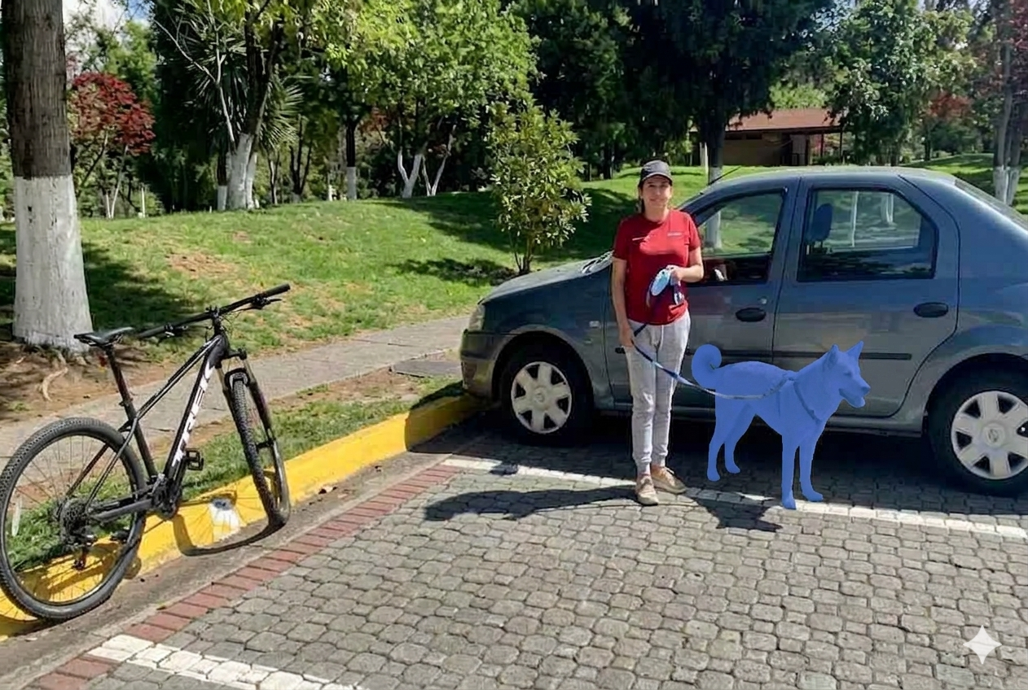
Promptable Image Segmentation -Motivation
From Detection to Segmentation
  Open-Vocabulary Detection asks:
  “Where is the Shiba Inu?”
  Output: Bounding Box
But sometimes a bounding box is not enough.
We need: “Which exact pixels belong to the Shiba Inu?”
Output: Segmentation Mask

Slide 23
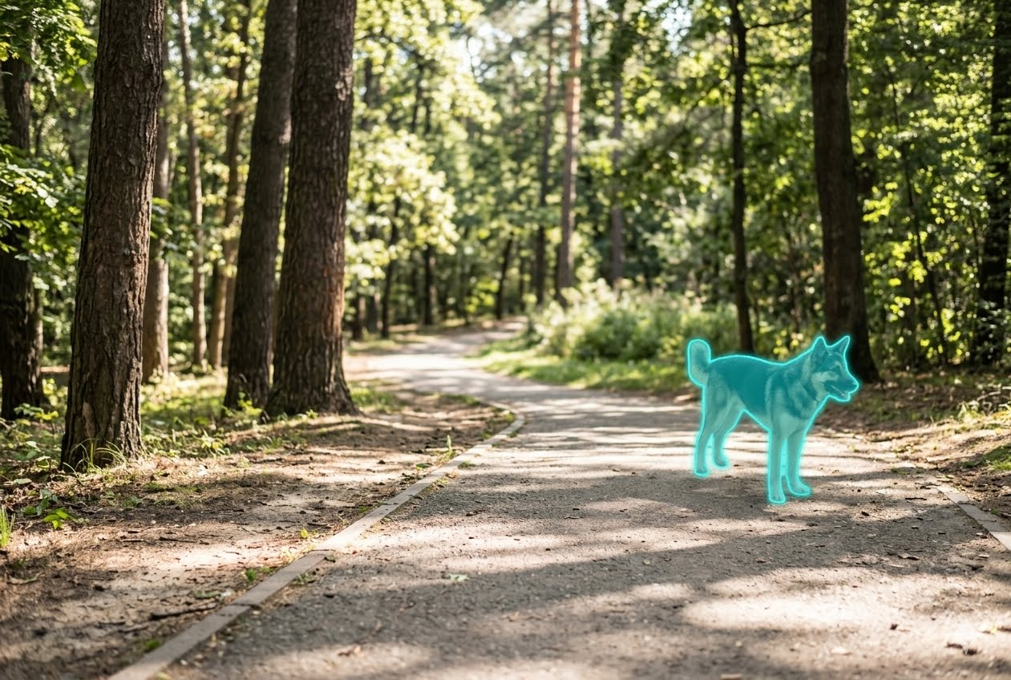
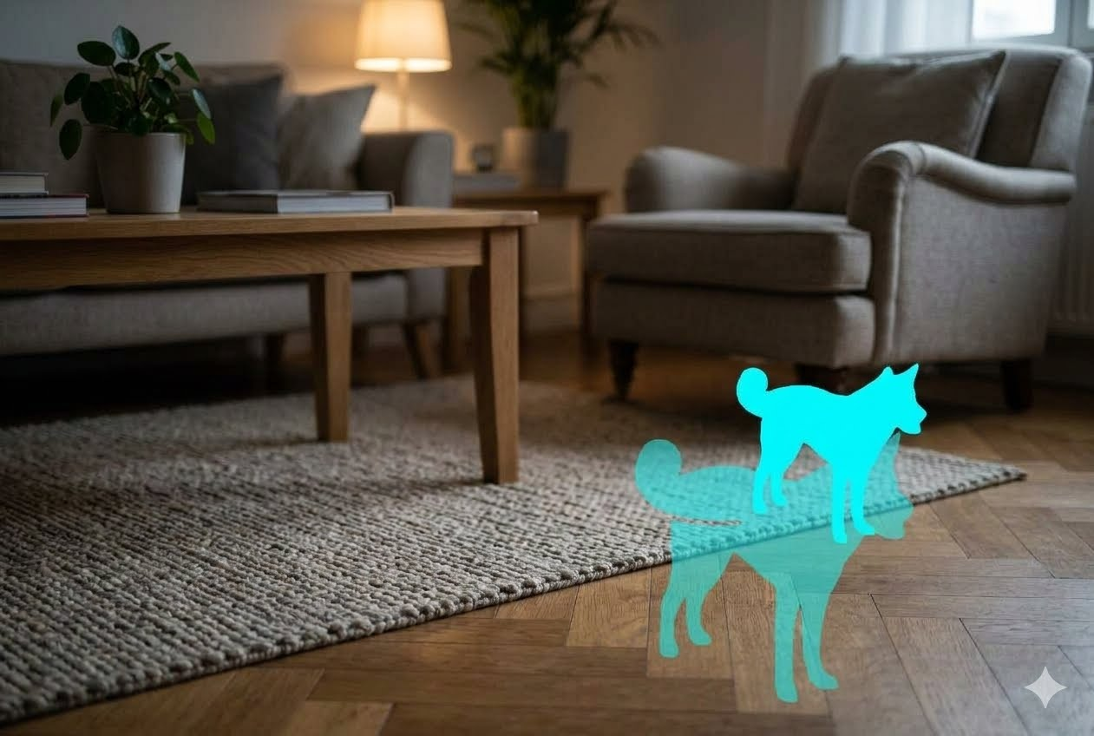
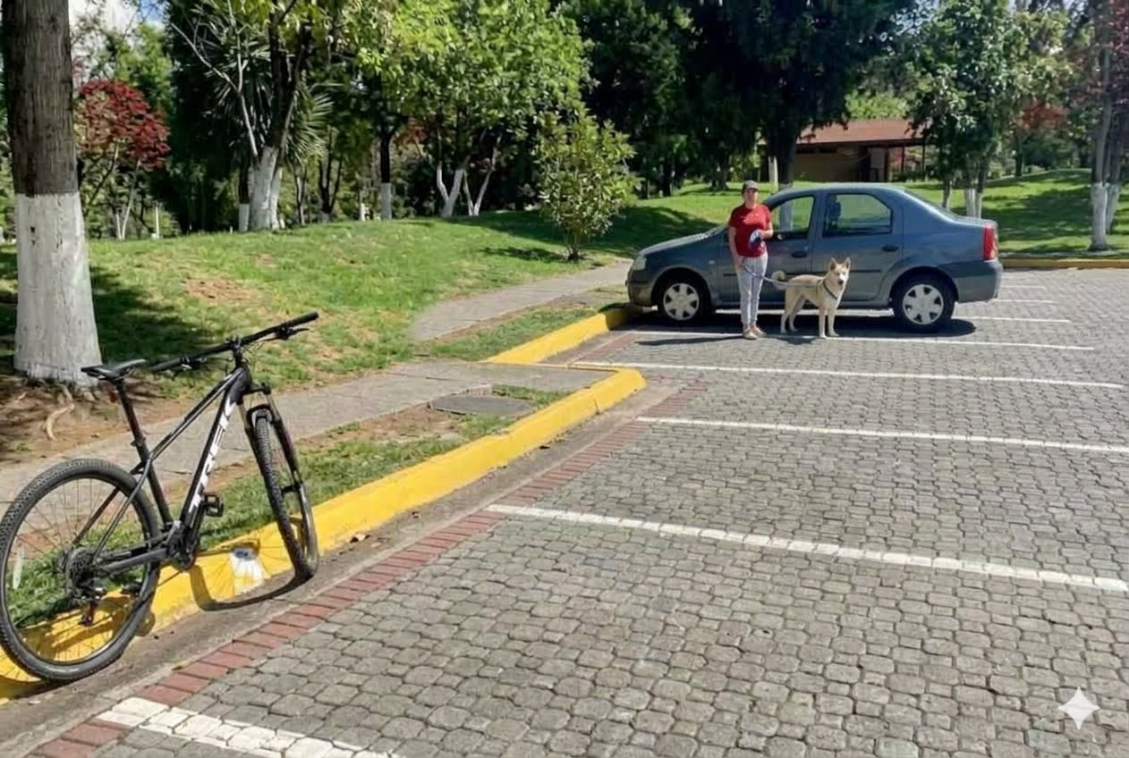
Promptable Image Segmentation -Motivation
Traditional Segmentation
  Depending on the approach:
  Classical CV
  Image → Thresholding / Edges / Regions / Morphology → Segmentation
Deep Learning
  Labeled Images + Pixel Masks → Train Segmentation Model → Fixed Task
  The second approach can require expensive pixel-level annotations.
CAN We use foundational model with a prompt? My experience –not so great requires iterative prompting (note- mask on previous page made with Gemini + prompts ---took me 10 tries and reiterations of prompt to get it right) → it gave me stuff like HMM?

Slide 24
Visual Question Answering & Multimodal Reasoning
Move beyond recognizing objects to reasoning about visual content

Slide 25
Visual Question Answering & Multimodal Reasoning
Is the dog standing closer to the person or to the bicycle?
IMAGE + NATURAL-LANGUAGE QUESTION
↓
VLM
↓
GENERATED ANSWER
Gemini
The dog is standing significantly closer to the person.
The person is holding the dog's leash directly next to it, while the bicycle is located on the far left side of the scene, separated by a stretch of pavement and a yellow curb.

Slide 26
Structured Visual Information Extraction
Turn unstructured visual content into structured data

Slide 27
Structured Visual Information Extraction
{
"objects": {
"people": 1,
"dogs": 1,
"bicycles": 1,
"cars": 1
},
"person": {
"standing": true,
"holding_dog_leash": true
},
"dog": {
"on_leash": true,
"near_person": true,
"near_vehicle": true
},
"bicycle": {
"parked": true
},
"vehicle": {
"type": "car",
"parked": true
}
}
This is NOT a new concept and is often pragmatically what we do in many ML based applications. But, it is worth emphasizing
Instead of asking a VLM:
  “Describe this image.”
  and receiving an unstructured paragraph, ask:
Ask:
  “Analyze this image and return the requested information using this JSON structure.”

Slide 28
Structured Visual Information Extraction -example
Gemini:
  “Describe this image.”
Gemini:
  “Analyze this image and return the requested information using this JSON structure.”
Core Subject and Scene
The image shows an outdoor scene in a paved parking or driveway area next to a park, featuring a woman, a dog, a car, and a bicycle [image_dA1Rhr.png].
Key Elements
The People and Animals: A woman wearing a red t-shirt, grey pants, a baseball cap, and sneakers stands near the center of the frame. She holds a blue leash attached to a medium-sized, light-colored (cream or off-white) dog with pointed ears and a curved tail [image_dA1Rhr.png].
The Vehicles: A grey or blue four-door sedan is parked directly behind the woman and dog. On the left side of the frame, a black Trek mountain bike rests against a yellow-painted curb [image_dA1Rhr.png].
The Background: The background consists of a grassy green hill with mature trees, some with white-painted lower trunks. A wooden building or shelter is visible in the distance among the trees [image_dA1Rhr.png].
Ground and Lighting: The ground is made of cobblestone or brick pavers. Bright, direct sunlight casts distinct shadows from the car, bicycle, and people onto the pavement [image_dA1Rhr.png].
If you want to focus on any specific part of this scene, let me know if you would like to analyze the bicycle components, discuss the dog's breed traits, or explore how computer vision models process this composition.
[ {"box_2d":, "label": "bicycle"}, {"box_2d":, "label": "car"}, {"box_2d":, "label": "person"}, {"box_2d":, "label": "dog"}]
YIKES –this isn’t very useful

Slide 29
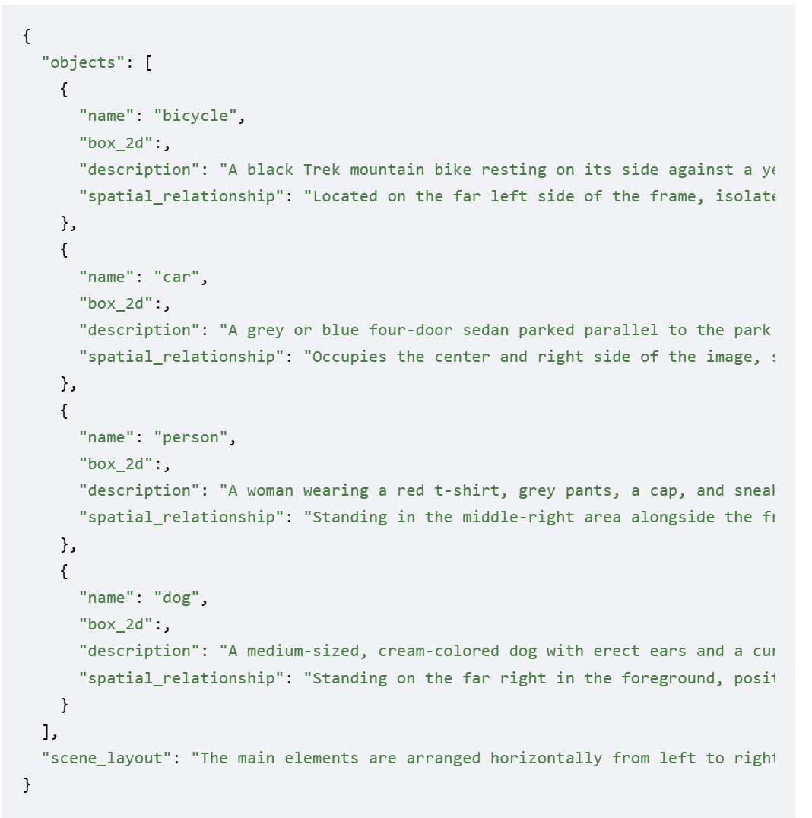
Structured Visual Information Extraction –example 2
Gemini:
  “describe the objects in the image and their relationship to each other spatially”
Gemini:
  “describe the objects in the image and their relationship to each other and return the information as structured JSON”
Spatial Distribution and Layout
The image features four main objects arranged horizontally across a cobblestone parking lane, set against a background of a grassy park hill and mature trees [image_Q00C37.png]. The layout moves from left to right: a bicycle, a parked car, a person standing beside the car, and a dog standing at the front of the vehicle [image_Q00C37.png].
[ BICYCLE ] [ CAR ]
(Far Left) (Center/Right)
|-- [ PERSON ] (Middle-Right)
|-- [ DOG ] (Far-Right / Foreground)
Detailed Objects and Spatial Relationships
🚲 Bicycle [image_Q00C37.png]
Position: Located on the far left side of the frame
Relationship: It rests isolated against a yellow-painted concrete curb. It sits a few meters away from the front-left bumper of the car, completely separated from the other elements by a section of pavement
🚗 Car
Position: Occupies the center to the right side of the frame
Relationship: It serves as the primary physical backdrop for the subjects in the scene It is parked parallel to the walkway behind the woman and the dog
👤 Person
Position: Positioned in the middle-right area of the image
Relationship: The woman stands on the pavement directly alongside the front-left door of the car . She is positioned between the vehicle's body and the dog, directly linking them both physically and visually as she holds the dog's leash .
🐕 Dog
Position: Positioned on the far right side, closest to the foreground.
Relationship: The dog stands on the cobblestones adjacent to the front wheel and bumper of the sedan. It is positioned directly in front of and to the right of the woman, connected to her hands by a blue leash extending across the space between them If you want to look into specific details, let me know if you would like to estimate the dimensions of the objects or analyze the shadow angles to determine the sun's position.
BETTER – prompts matter

Slide 30
Model Adaption
Evolution of Model use → Adaption

Slide 31
Adaption Spectrum
  Prompting
  ↓
  Few-Shot / In-Context Examples
  ↓
  Use Frozen Embeddings + Train Small Classifier
  ↓
  Parameter-Efficient Fine-Tuning (PEFT / LoRA)
  ↓
Fine-Tuning
See next for example

Slide 32
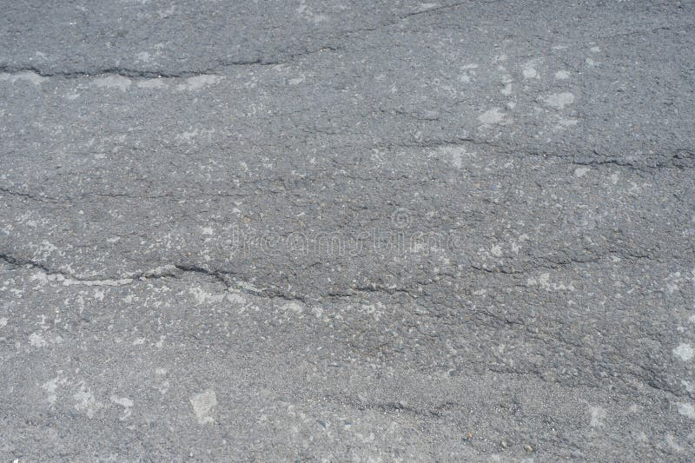
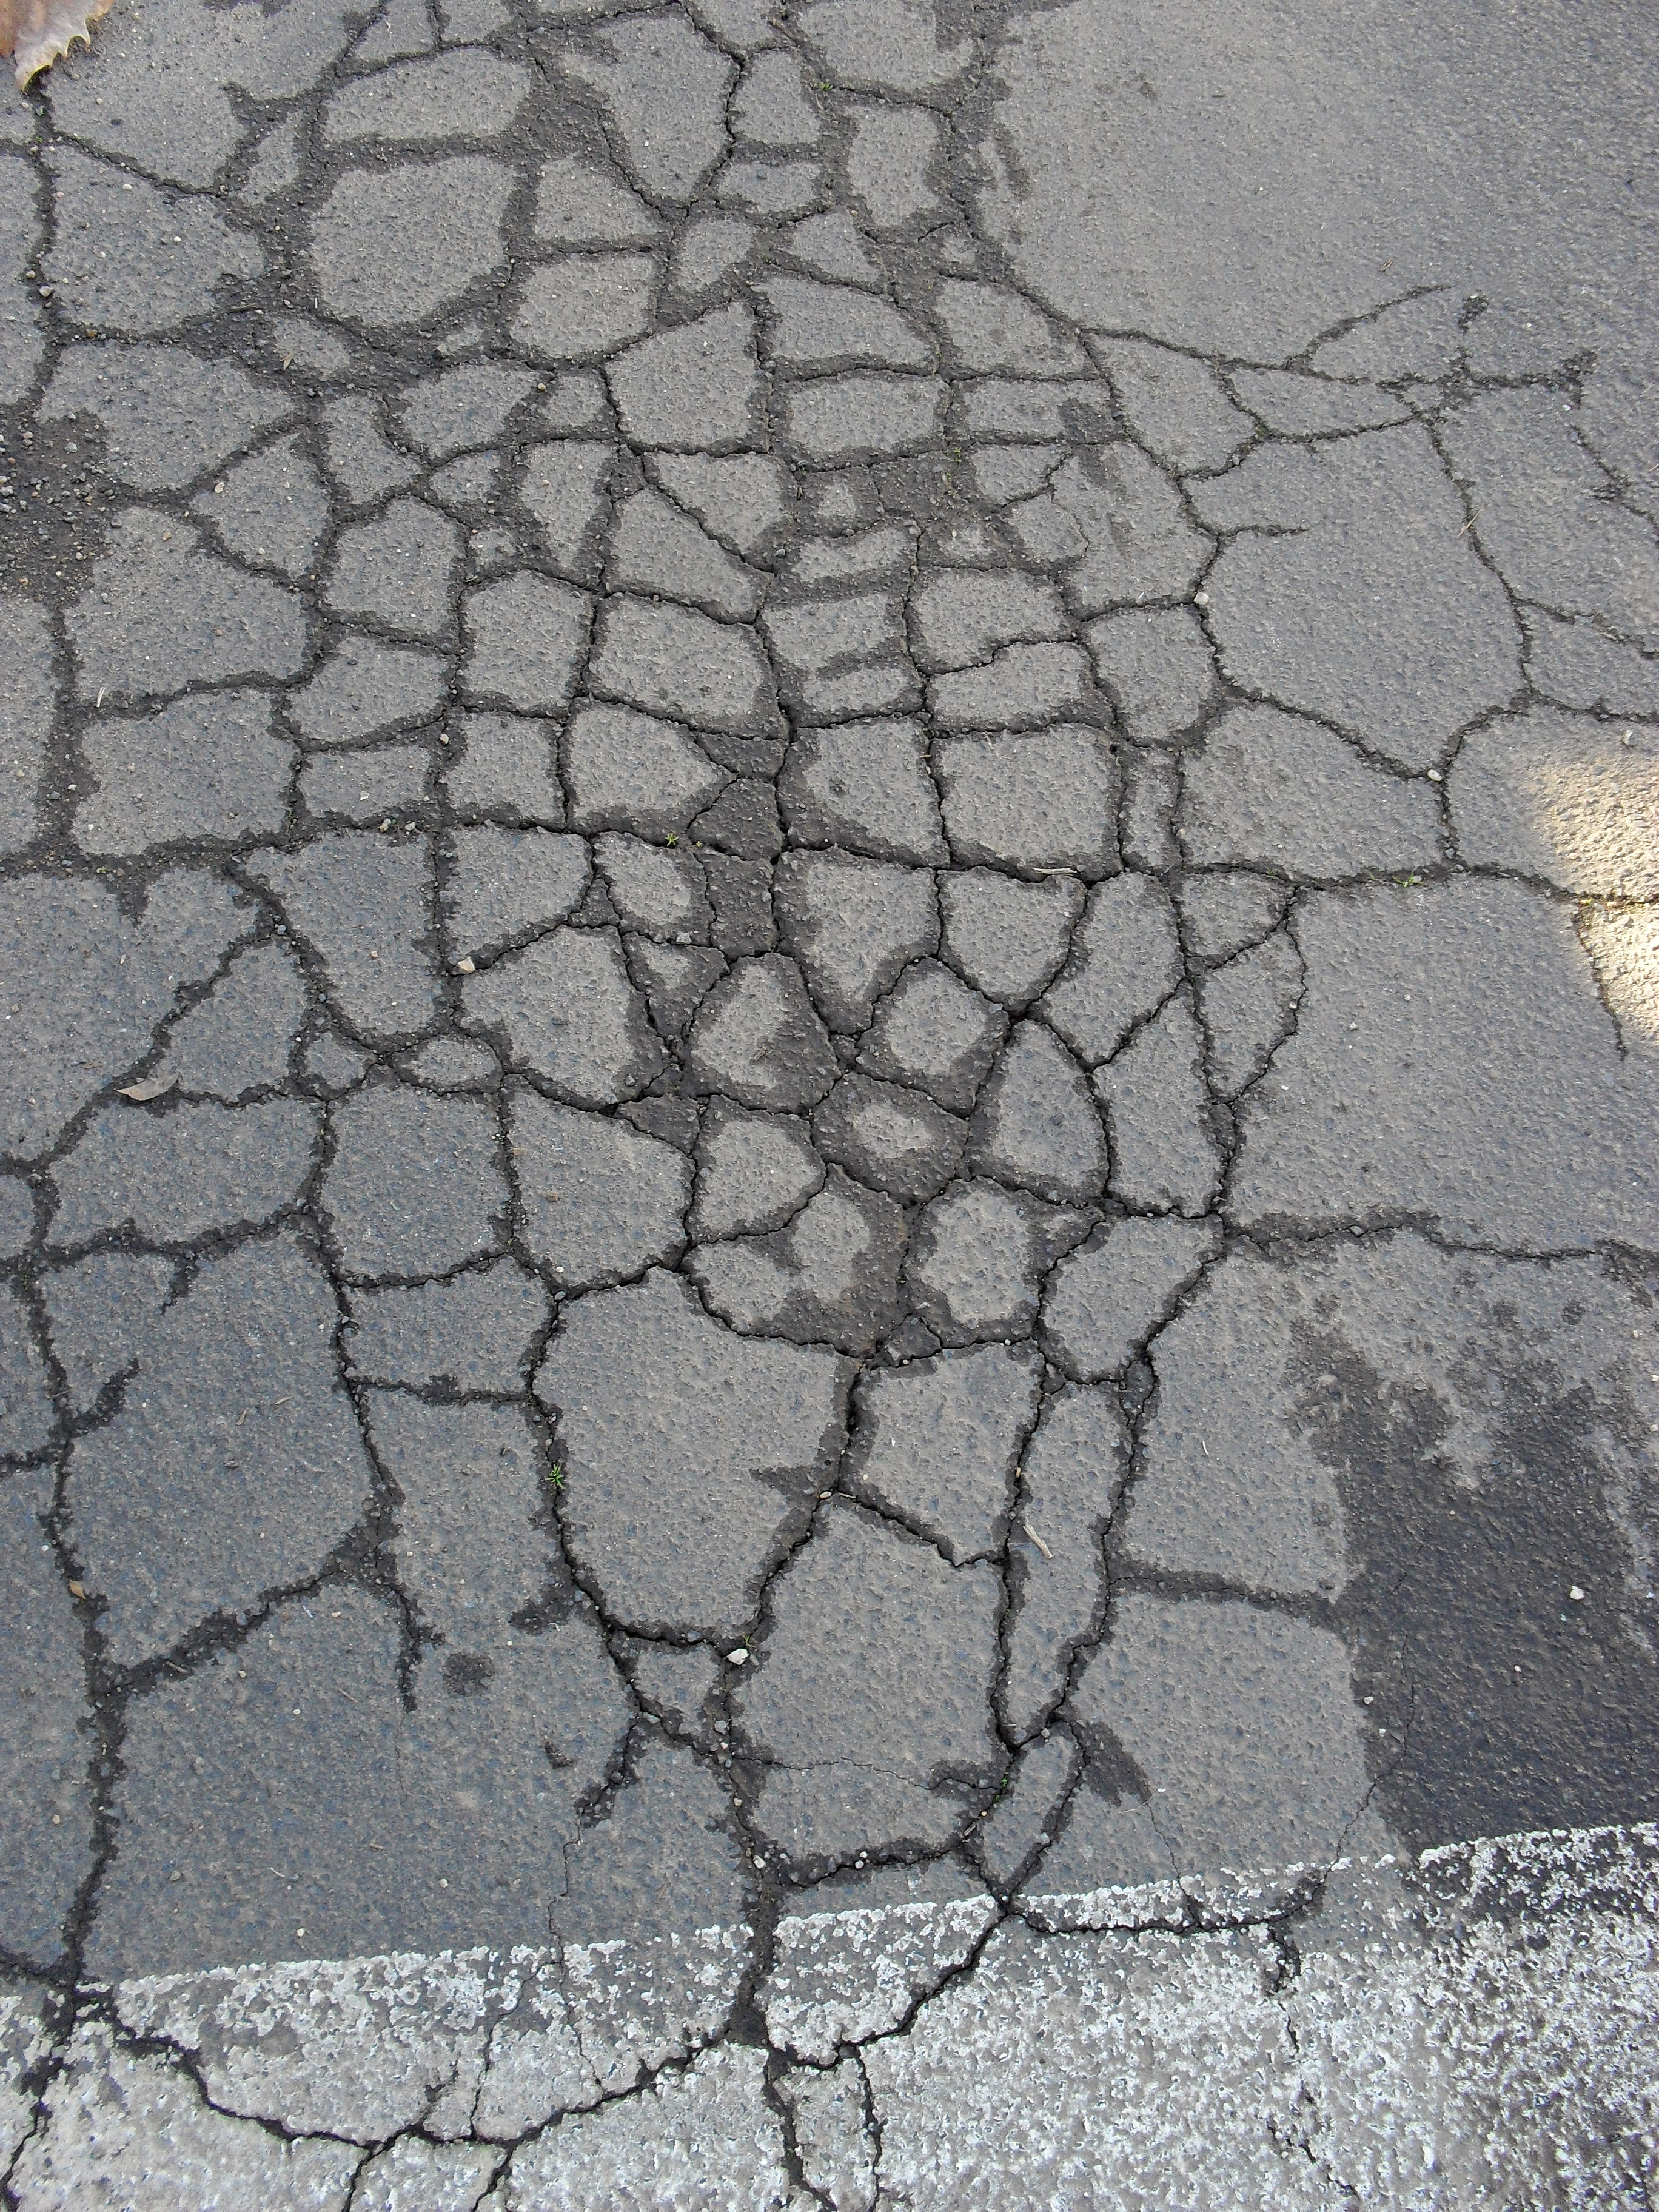
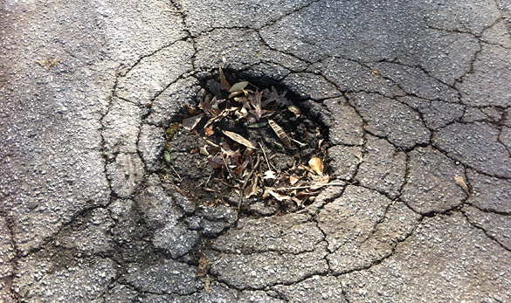
Example:
Prompting
Change only the instruction.
  "Classify pavement damage according to the following severity definitions...“
Few-Shot / In-Context Examples
Give the model examples:
    Image A → Minor
    Image B → Severe
    Now classify this image.
Model weights do not change.
Frozen Foundation Model + New Classifier
    Image
    ↓
    Pretrained Foundation Model
    ↓
    Embedding
    ↓
    Small Task-Specific Classifier
    ↓
    Severity
Foundation model remains frozen.
Parameter-Efficient Fine-Tuning
Update only a small portion/additional set of parameters rather than the entire foundation model.
Examples:
    LoRA • Adapters • other PEFT approaches
Benefits can include:
    less GPU memory • less training time • smaller task-specific updates
(Full) Fine-Tuning
Update model parameters using a task-specific dataset.
Suppose a pretrained vision foundation model must distinguish:
Minor pavement crack
Moderate pavement damage
Severe pavement damage
The foundation model may understand pavement damage, but not our application's specific severity definitions.

Slide 33
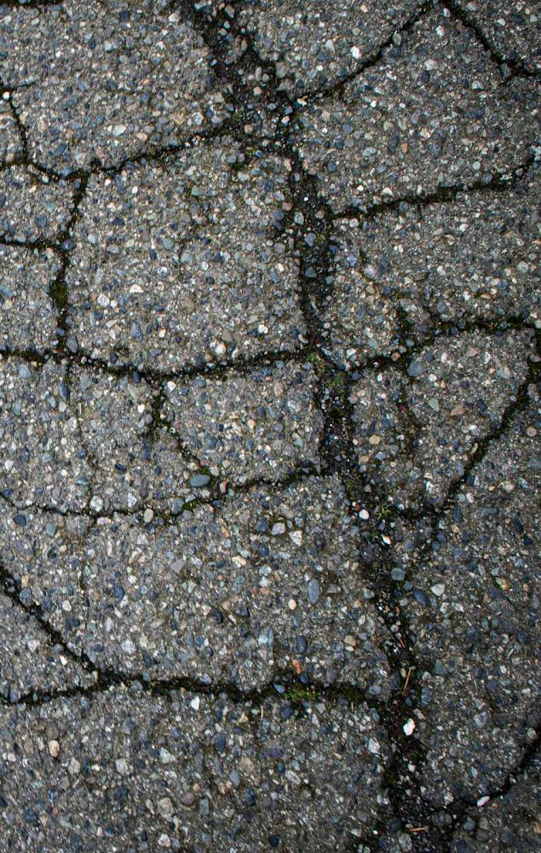
Example:
Prompting
Change only the instruction.
  "classify the image as minor, moderate or severe damage.“
  NOTE: this was given to me by Gemini as a moderate crack example
Gemini Output
The image shows severe damage.
Classification Breakdown
This section of alligator cracking has progressed to the highest severity level based on the following indicators:
Spalling and Erosion: The edges of the cracked blocks are actively breaking down, eroding, and widening.
Debris and Vegetation: Deep, dark voids have formed between the pieces, which are collecting dirt, organic matter, and small bits of broken pavement.
Loose Structural Integrity: The individual pieces are becoming loose and detached from one another. They will easily dislodge under traffic load, directly leading to pothole formation.
Recommended Next Steps
Surface treatments or thin asphalt overlays will immediately fail on this surface. Complete extraction of the failed asphalt and repair of the compromised subgrade layer beneath it are required.
To help evaluate the scope of your project, tell me:
The intended usage of the pavement (e.g., standard residential driveway, commercial parking lot, heavy truck lane).
The total dimensions or square footage of the impacted area.
Suppose a pretrained vision foundation model must distinguish:
Minor pavement crack
Moderate pavement damage
Severe pavement damage
The foundation model may understand pavement damage, but not our application's specific severity definitions.

Slide 34
Foundation Models as Components of AI/CV Systems
A foundation model does not have to be the entire application → enabling pipelines, workflows, and agentic architectures

Slide 35
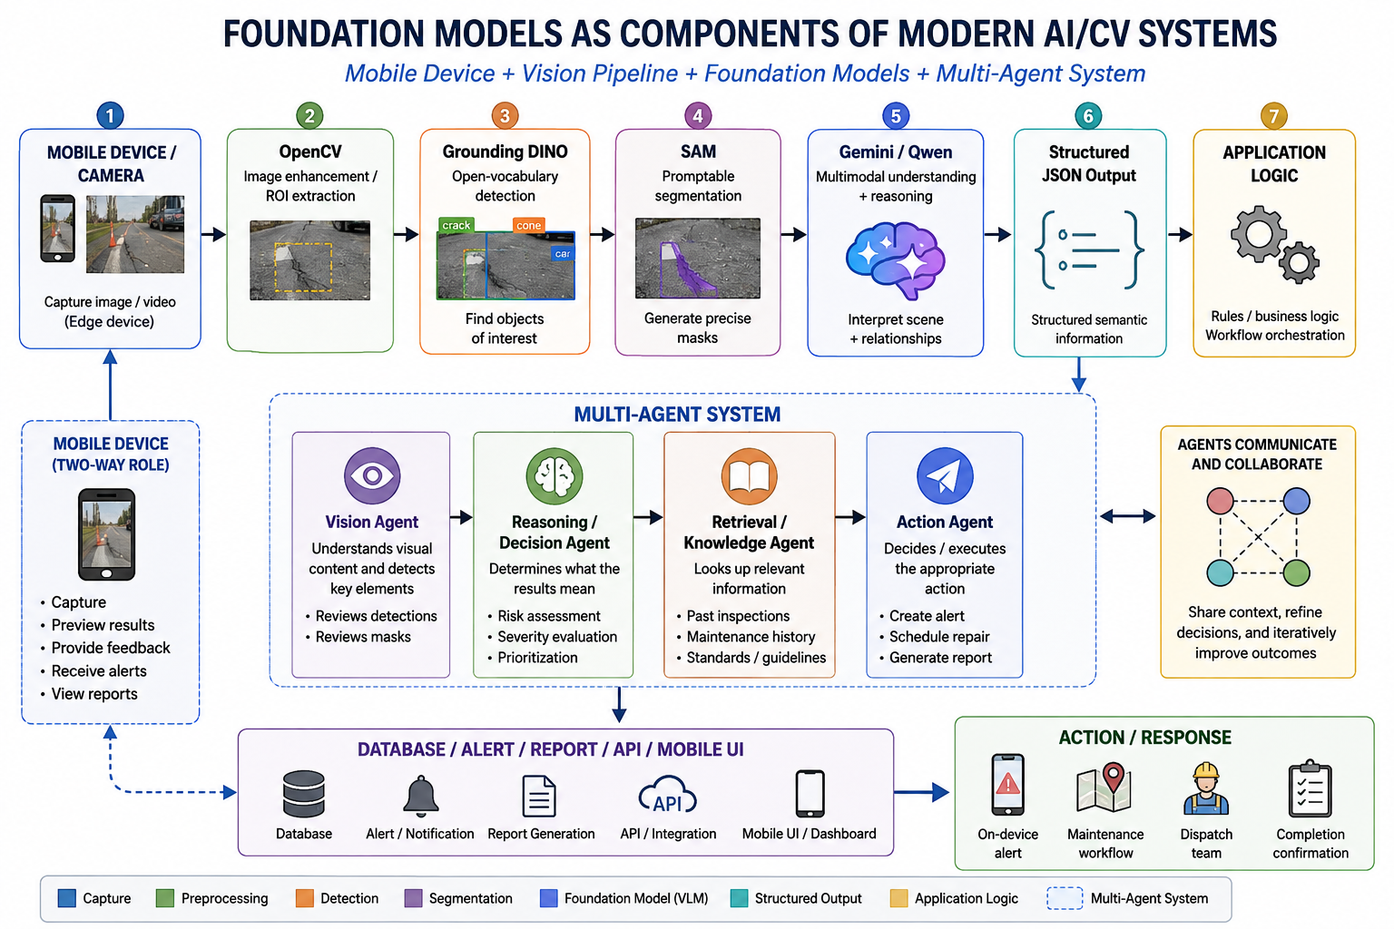
Action / Customization/ Tooling / Agents
Traditional CV + Specialized ML Models + Foundation Models + VLMs + External Tools

Slide 36
Using Vision Foundation Models — Summary

Slide 37
Using Foundation Models → Summary w/ Common Models/Approaches
How We Use the Foundation Model | What It Enables | Common Models / Approaches
Visual Representations / Embeddings | Feature extraction, similarity, clustering, downstream classifiers | CLIP, SigLIP, DINO/DINOv2, other embedding-capable vision encoders; generative VLMs also learn visual representations, although APIs may not expose them directly
Semantic Image Retrieval | Image→image and text→image search; vector databases; visual RAG | CLIP, SigLIP, DINOv2 for visual similarity; multimodal embedding models
Zero-Shot Classification | Define new recognition categories at inference time without task-specific training | CLIP, SigLIP via image↔text similarity; Gemini, GPT vision models, Qwen-VL via prompting
Open-Vocabulary Object Detection | Find and localize objects described with natural language | Grounding DINO, OWL-ViT/OWLv2 and other open-vocabulary detectors
Promptable Segmentation | Specify an object/region at inference time and obtain a pixel-level mask | SAM-family models; often combined with open-vocabulary detectors for text→box→mask pipelines
Visual Understanding / VQA / Reasoning | Captioning, questions, relationships, scene interpretation, multimodal reasoning | Gemini, GPT vision-capable models, Qwen-VL and other generative VLMs
Structured Visual Information Extraction | Image→JSON/schema, attributes, relationships, application-specific information | Gemini, GPT vision-capable models, Qwen-VL and other generative VLMs with structured-output prompting
Task / Domain Adaptation | Specialize a general foundation model for a particular application | Prompting → in-context/few-shot examples → frozen embeddings + classifier → PEFT/LoRA/adapters → full fine-tuning
Components in Larger AI/CV Systems | Combine specialized vision, reasoning, retrieval, mobile/edge processing, and agents | OpenCV + CLIP/DINO + Grounding DINO + SAM + Gemini/Qwen/GPT + vector DB/RAG + agents/workflows, selecting only the components the application needs

Slide 38
One last word on words (naming)
Vision Foundation Models (and multi-modal Vision/Language Models)
│
┌────────────────┴───────────────────┐
│ │
Specialized / Representation Generative VLMs
Vision Models (Vision + Language)
│ │
VisLangEmb: CLIP / SigLIP Gemini
VisEmb: DINOv2 GPT vision-capable models
Segmentation: SAM Qwen-VL
OVD: OWL-ViT/ Grounding DINO
VisLangEmb: vision-language representation model, maps images and text into the same embedding space (like features)
VisEmb: Vision model to learn visual embeddings (like features)
OVD= Open-Vocabulary Object Detection

